Slide 1
The Essence and Application of Intelligent Swarm Algorithm
Experimental improvement of code algorithm based on BWO algorithm
汇报人：Jerry Huang/Kaifeng Jin

Slide 2
目录
01
02
03
04
Overview of Intelligent Swarm Algorithms
Fundamentals and Implementation of BWO Algorithm
Advantages and limitations of BWO algorithm
Comparison and Replacement of BWO Algorithm with Other Algorithms

Slide 3
Overview of Intelligent Swarm Algorithms
01

Slide 4
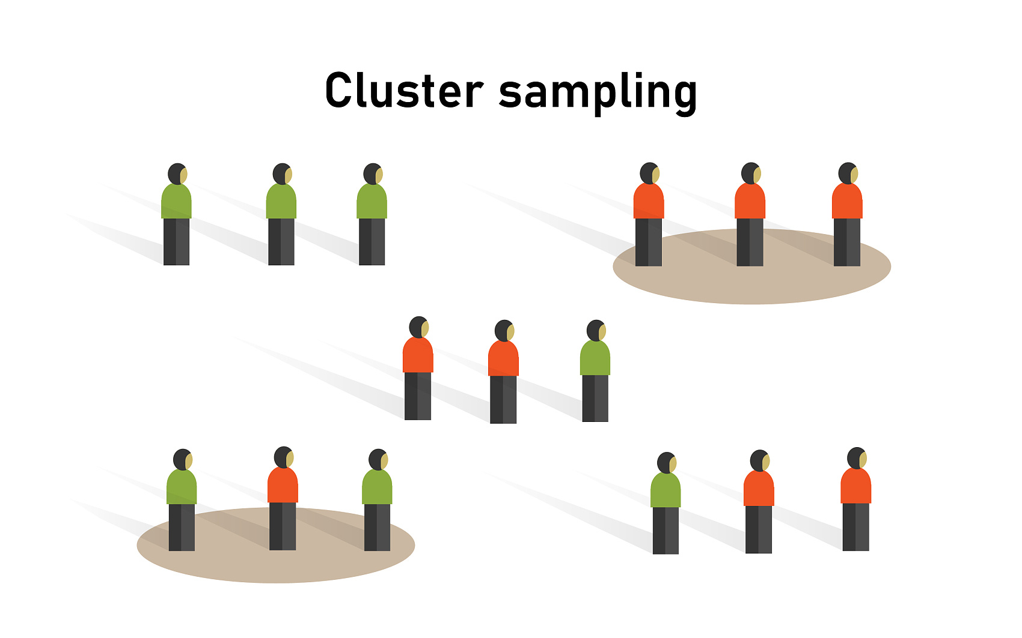
What is intelligent swarm algorithm
01、
Definition
02、
Common examples
Intelligent swarm algorithm is a type of optimization algorithm that simulates the behavior of natural biological groups. It seeks the optimal solution in complex environments by simulating the simple behavioral rules of individuals in the group.
Common intelligent swarm algorithms include Guanhao Pig Optimization Algorithm (CPO), Dandelion Optimization Algorithm (DO), and Mountain Antelope Optimization Algorithm (MGO), which simulate the collective behavior of different organisms.

Slide 5


Classification
Classified by behavior pattern
Classified by algorithm structure
Intelligent swarm algorithms can classify based on simulated biological behavior patterns, such as predation, migration, reproduction, etc.
According to different algorithm structures, intelligent swarm algorithms can be divided into population-based algorithms and individual based algorithms. The former emphasizes collaboration between groups, while the latter emphasizes individual autonomy.

Slide 6

The fitness of algorithms and the concept of location
The meaning of optimal fitness
In intelligent swarm algorithms, optimal fitness refers to the fitness value of the optimal solution reached by individuals in the group in the current iteration, and it is an important indicator for measuring the quality of the solution.
Determination of the optimal location
The optimal position corresponds to the position of the solution with the best fitness, and the algorithm gradually approaches the global optimal solution by continuously updating the individual's position and velocity.

Slide 7
Fundamentals and Implementation of BWO Algorithm
02

Slide 8


Implementation mechanism of the first stage position change
Generation of the initial population
Position update rules
In the first stage of the BWO algorithm, the initial population is randomly generated, with individuals' positions and velocities randomly distributed within the feasible solution space to ensure the algorithm's exploratory nature.
Considering the swimming behavior of beluga whales, the position update rules are designed as the exploration phase of the BWO algorithm. Beluga whales can engage in social behaviors in different postures, such as two whales swimming closely in a synchronized or mirrored manner. This behavior is translated into the mechanism for updating the positions of individuals in the algorithm.

Slide 9


Analysis of the roles of the second and third stages
Exploration and Development Phase Two
Convergence and optimization in the third phase
The inspiration for the development stage of the BWO algorithm comes from the hunting behavior of beluga whales. Beluga whales can move and forage based on the positions of nearby beluga whales. They forage by sharing their positions with each other, thus considering the impact of the best individual and the updates of other individuals' positions. During the development stage of the BWO algorithm, the Levy flight strategy was introduced to enhance convergence.
The third phase mainly focuses on the convergence process of the algorithm, by simulating the hunting behavior of whale groups, the algorithm concentrates on the vicinity of currently discovered high-quality solutions to improve the quality and accuracy of the solutions. The purpose of this phase is to ensure that the algorithm can find the global optimal solution quickly while converging, reducing unnecessary iterations.

Slide 10
Advantages and limitations of the BWO algorithm
03

Slide 11




Advantages of the BWO algorithm
Locally convergent functions with strong convergence
The BWO algorithm, by simulating the social behavior of whales, enables the entire whale population to converge towards the location of the local optimum during the hunting phase, enhancing the convergence of the function and finding better local or even global optimal solutions.
Simple parameter settings
Compared to other intelligent swarm algorithms, the parameter settings of the BWO algorithm are relatively simple and easy to adjust. The main parameters of the algorithm include population size, iteration number, and Levy flight parameters, among others. The setting of these parameters does not require a complex tuning process, making the algorithm easier to implement and apply.

Slide 12


Disadvantages of the BWO algorithm
Insufficient global search capability
Dependency on random numbers
Although the BWO algorithm performs well in global search, its local search capability may not match some algorithms specifically designed for global optimization. The transition between its cruising phase and exploitation phase relies too heavily on random numbers, which can lead to insufficient ability in local search and sometimes makes it difficult to find more refined optimal solutions.
The BWO algorithm relies heavily on random numbers during its implementation, especially during the exploration phase, which can affect the stability and convergence speed of the algorithm. In some cases, the algorithm may require more iterations to achieve satisfactory convergence results.

Slide 13
Comparison and replacement of BWO algorithm with other algorithms
04

Slide 14
Comparison of BWO Algorithm with Other Intelligent Swarm Algorithms
Replace the cruising phase of the BWO algorithm with the first phase of other algorithms.
Given that the initial population positioning of various intelligent swarm algorithms is similar at the beginning, the exploration phase of other intelligent swarm algorithms can be used to replace the exploration process of the first phase, achieving a seamless connection in the coordinate change process. Such a replacement can ensure a broader global search capability while maintaining the strong convergence of local search.

Slide 15
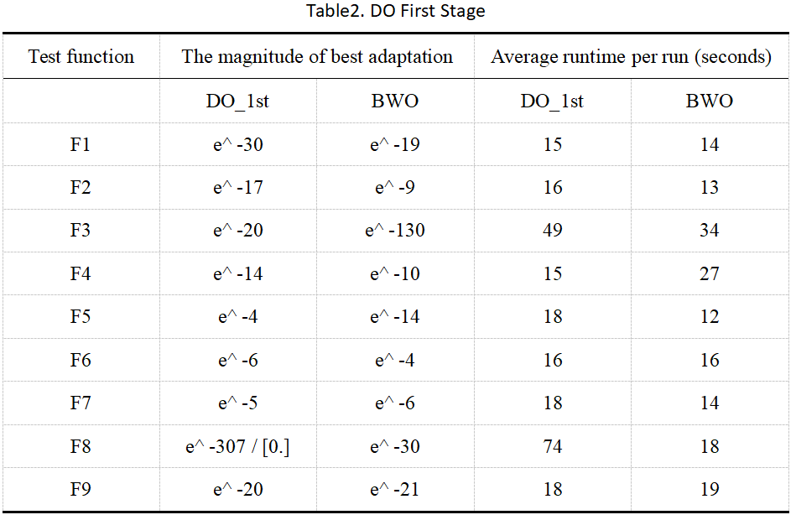
Comparison of BWO Algorithm with Other Intelligent Swarm Algorithms

Slide 16
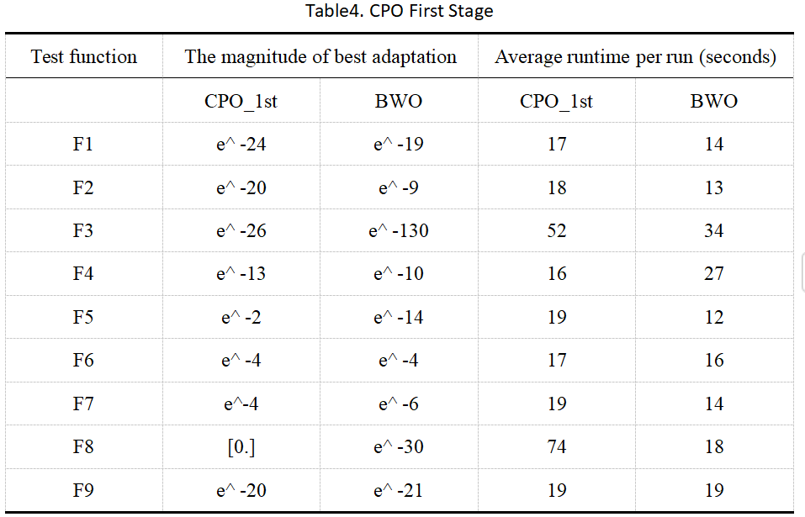
Comparison of BWO Algorithm with Other Intelligent Swarm Algorithms

Slide 17
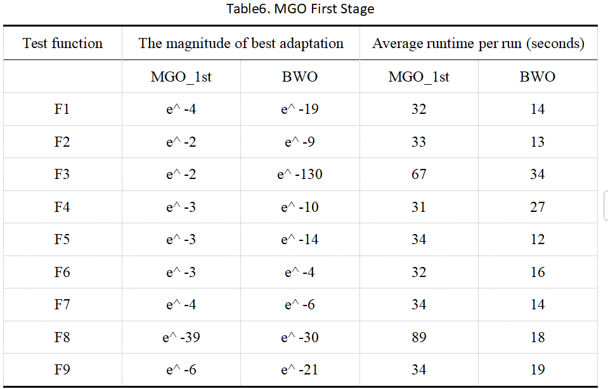
Comparison of BWO Algorithm with Other Intelligent Swarm Algorithms

Slide 18
Comparison of BWO Algorithm with Other Intelligent Swarm Algorithms
Replace the cruising phase of the BWO algorithm with the second phase of other algorithms.
Whether in DO's raining/descending phase or CPO's defensive stages, incorporating BWO's predation phase guidance is crucial. Omitting it leads to performance decline. We validated this with an experimental control group.

Slide 19
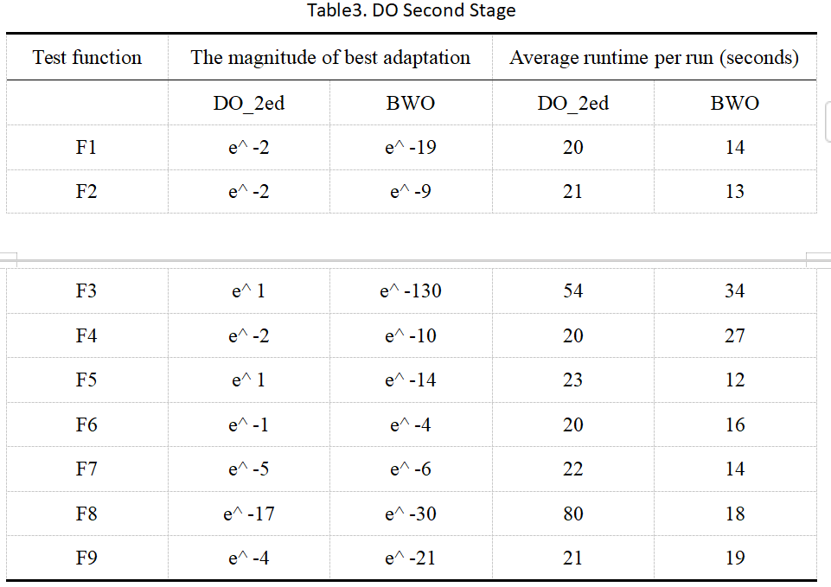
Comparison of BWO Algorithm with Other Intelligent Swarm Algorithms

Slide 20
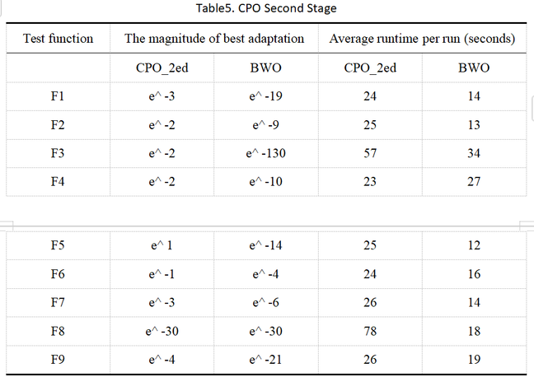
Comparison of BWO Algorithm with Other Intelligent Swarm Algorithms

Slide 21
Comparison of BWO Algorithm with Other Intelligent Swarm Algorithms
Combinations of other algorithm stages
After replacing different stages of the BWO algorithm, we also attempted to use combinations of different algorithms. We tried using the first stage of the DO algorithm and the second stage of the CPO algorithm combined with the third stage of the BWO algorithm. The performance of this combined algorithm is as follows:

Slide 22
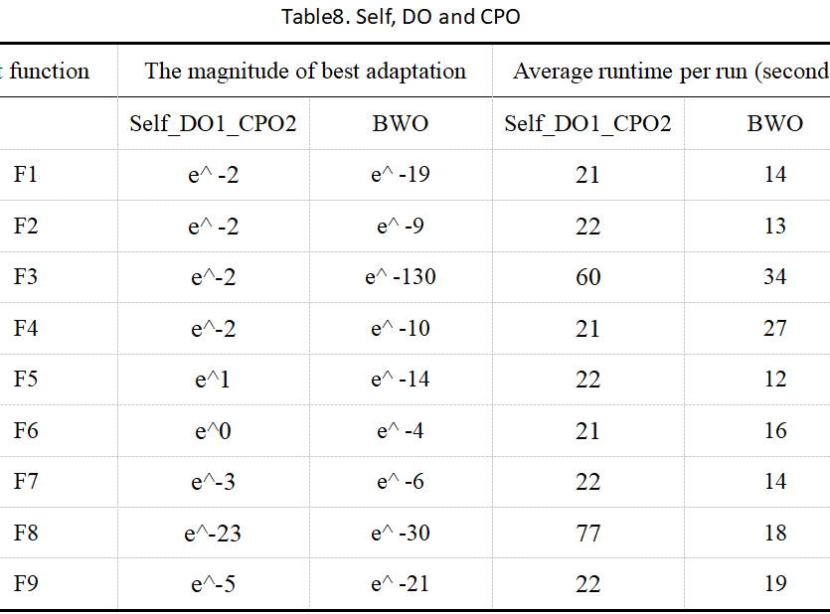
Comparison of BWO Algorithm with Other Intelligent Swarm Algorithms
From the graph, it can be seen that the performance of this combined algorithm is even worse than replacing the second stage with BWO. I speculate that the possible reason is: DO algorithm has strong global search ability in the first stage, which makes the population uniformly distributed in the function space, but in the second stage, the convergence ability of the function is not as good as the predatory stage of BWO. This weaker convergence ability cannot efficiently complete the function optimization like BWO, resulting in poorer performance of the entire model.

Slide 23
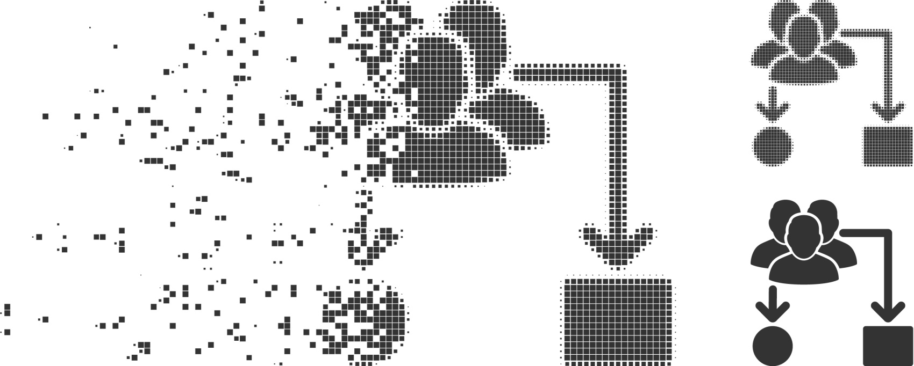
Comparison of BWO Algorithm with Other Intelligent Swarm Algorithms
Scalability Analysis of Algorithms
Through experiments involving the replacement at different stages and the combination of algorithms, we have found that the best individual and the best position play a crucial role in the convergence performance of the second-stage function. Therefore, we wonder if introducing the best position guidance into the global search of the first stage would enhance the model's search capability.

Slide 24
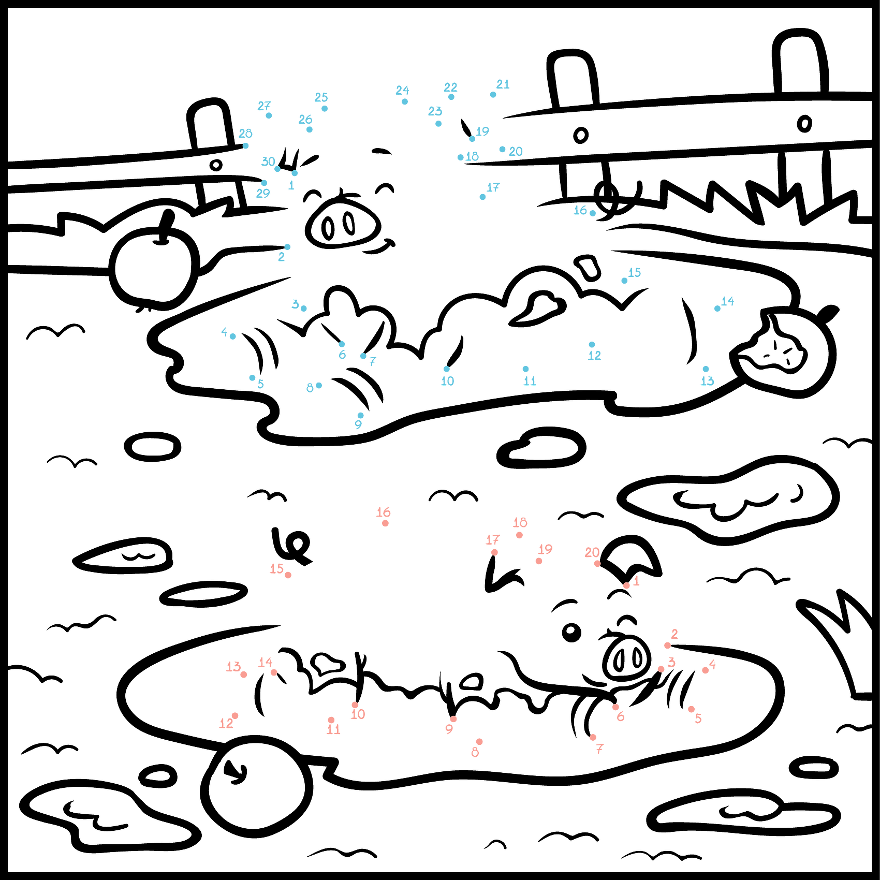

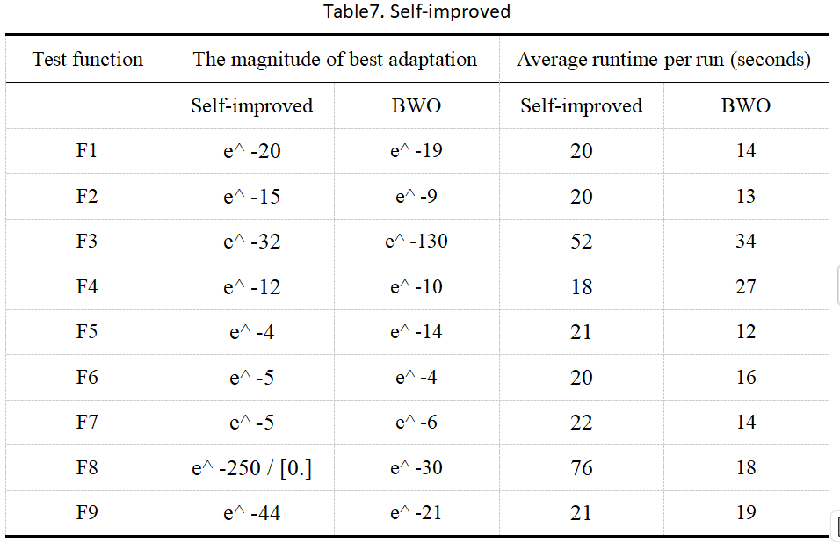
Comparison of BWO Algorithm with Other Intelligent Swarm Algorithms
Using the best individual as a guide
Positional changes of intelligent swarm algorithm are based on random numbers. Whales may find good positions but move elsewhere in updates. Using best position as guide can make all whales approach it. We improve position transformation in BWO's first phase using best position as guide. This maintains global search breadth and enhances local search convergence.

Slide 25
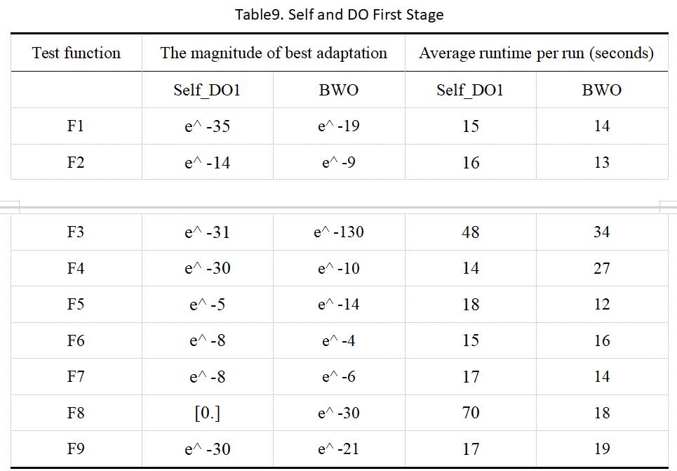
Comparison of BWO Algorithm with Other Intelligent Swarm Algorithms
Using the best individual as a guide
The newly constructed algorithm model leverages the excellent global search capability of the DO algorithm and the powerful function convergence ability of the BWO algorithm. Additionally, by introducing an algorithm function guided by the best position during the global search process, our model has significantly improved in the prediction of the F8 function and has also shown performance enhancements in the testing of other functions.

Slide 26
Comparison of BWO Algorithm with Other Intelligent Swarm Algorithms
Pseudocode demonstration
1. Initialize variables and parameters:
- Best solution `xposbest` and its fitness value `fvalbest`.
- Population positions `pos` within bounds defined by `lb` and `ub`.
2. Evaluate fitness of the population, sort individuals, and record the current best solution and fitness value.

Slide 27
Comparison of BWO Algorithm with Other Intelligent Swarm Algorithms
Pseudocode demonstration
3. Begin iterations (loop until reaching maximum iterations `Mapos_iter`):
- Compute dynamic parameters:
- `WF` (whale fall probability), decreases over time.
- `kk` (random list), used to distinguish exploration and exploitation phases.
- For each individual in the population:
- If the individual is in the **exploration phase** (swimming):
- Randomly select parameters and update positions using sine and cosine functions.
- If the individual is in the **exploitation phase** (predation):
- Update positions based on the global best solution and Levy flight.
- Apply boundary constraints.
- Check whale fall conditions:
- If conditions are met, perform additional position updates.
- Update the population positions and fitness values.
- Sort the population again and update the global best solution and fitness value.
4. Record results and output the best solution.

Slide 28
Thank you

